Slide 1
Constructionist Design in Compiler Education:
A Critical Evaluation of CS 327
By Pranav Joshi & Divya Gautam
Date: 2 November 2025

Slide 2
Learning Goals
Develop actual competence in compiler design and implementation.
Build a sense of competence (confidence) to take on compiler-related tasks.
Foster intrinsic motivation and long-term interest in compiler systems.
Core Skills:
Programming language theory, compiler and interpreter design, VM understanding.
Teamwork, time management, and balancing usability with creativity.

Slide 3
Course Context and Design Rationale
Course: CS 327 - Compiler Construction (CSE Elective).
Target Group: Students pursuing industry-oriented careers in software and systems.

Slide 4
Learning Design & Features
Assessment Weightage: 20% exams, 30% assignments, 50% projects.
Lecture Design: Just-in-time introduction of theory during project work.
Scaffolding: One-on-one TA guidance in labs, adaptive feedback.

Slide 5
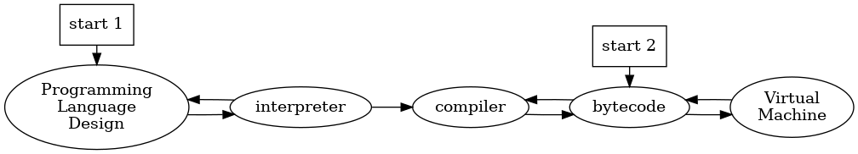
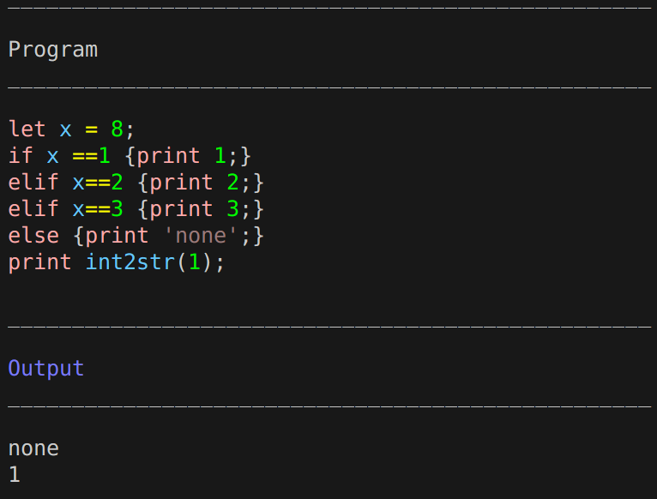
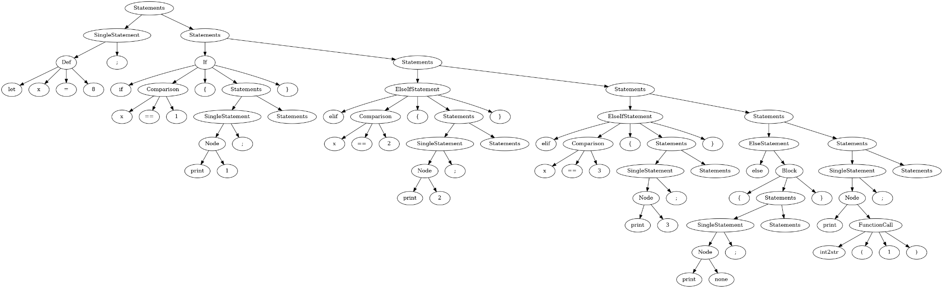
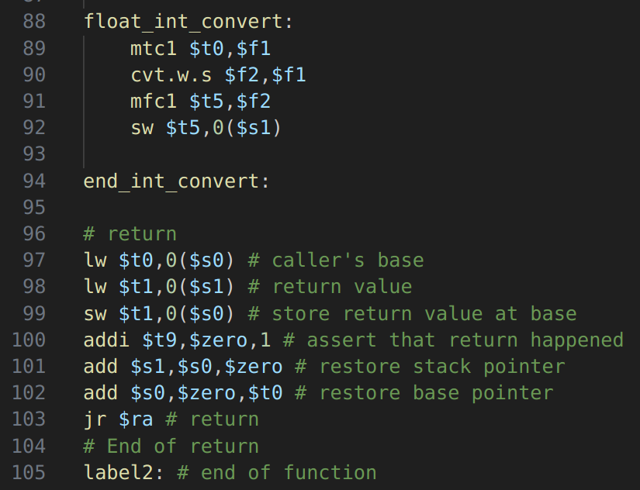
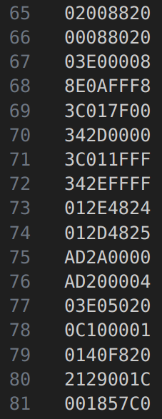
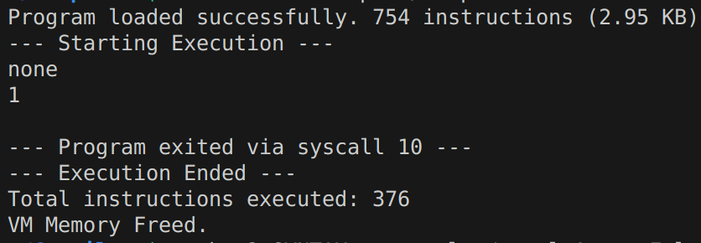
Sequential Pipeline

Slide 7
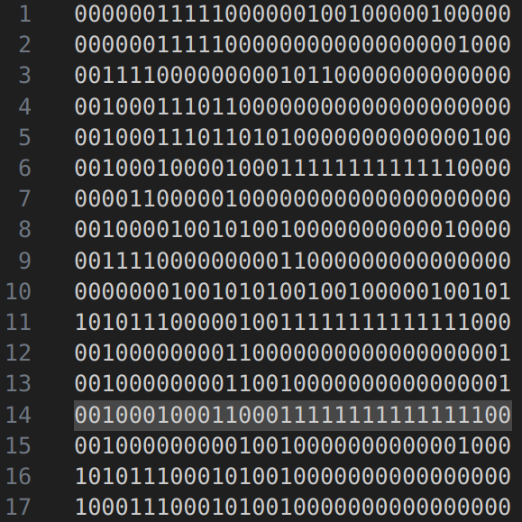
Intermediate Code (MIPS32)
Bytecode

Slide 8
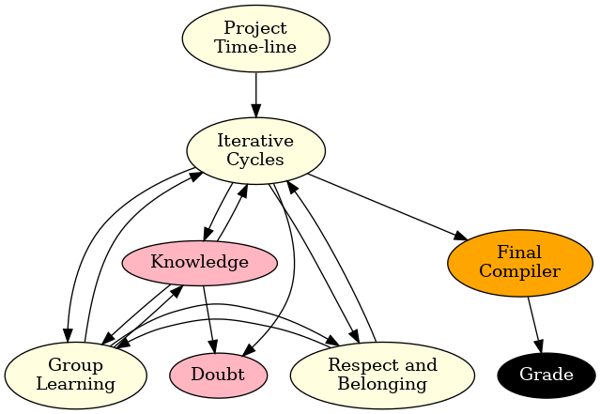
Completely project based (Minimal Guidance)
Weak doubt resolution
Cognitive overload
Confusion and Anxiety

Slide 9
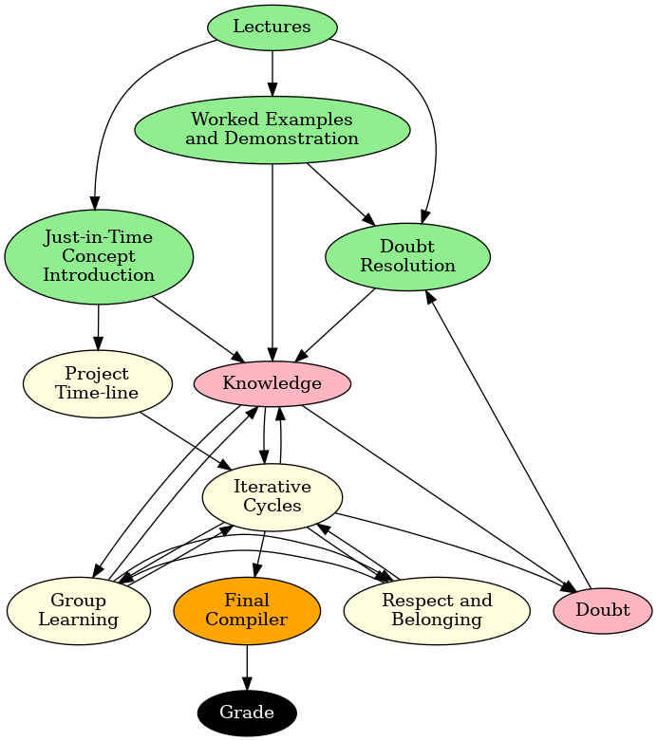
Project + Lectures
Pros:
Allows for modeling through worked examples
Timely scaffolding through JIT concept introduction.
Cons:
Low one-to-one monitoring and feedback due to variability in speed of teams.
Can’t assess student knowledge and adapt lectures continuously because of large student-teacher ratio.

Slide 10
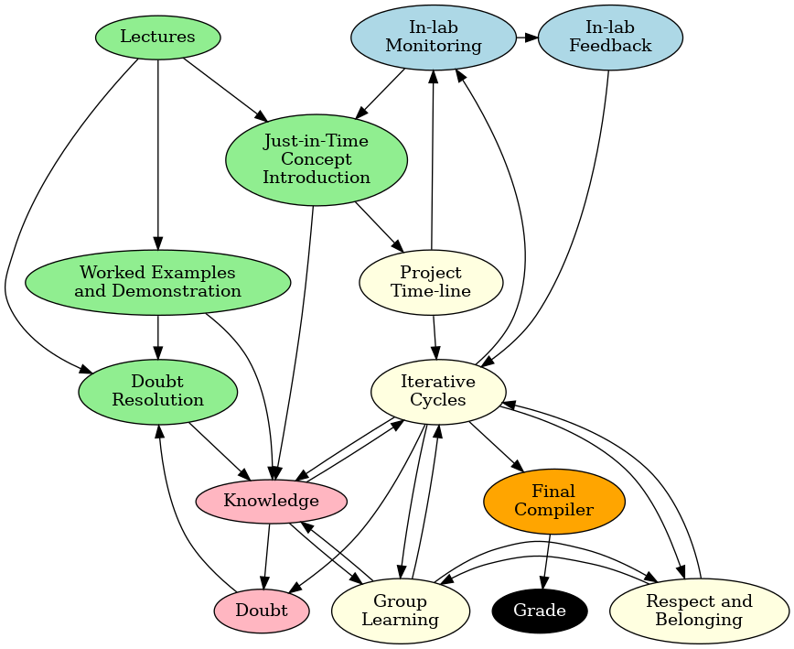
Guided constructionism
Pros:
Allows for articulation
Better monitoring and thus JIT concept introduction
Better one-on-one feedback
Cons:
No way to assess actual knowledge gained (AI, plagiarism, etc.)
No way to assess teamwork
Freeloader problem

Slide 11
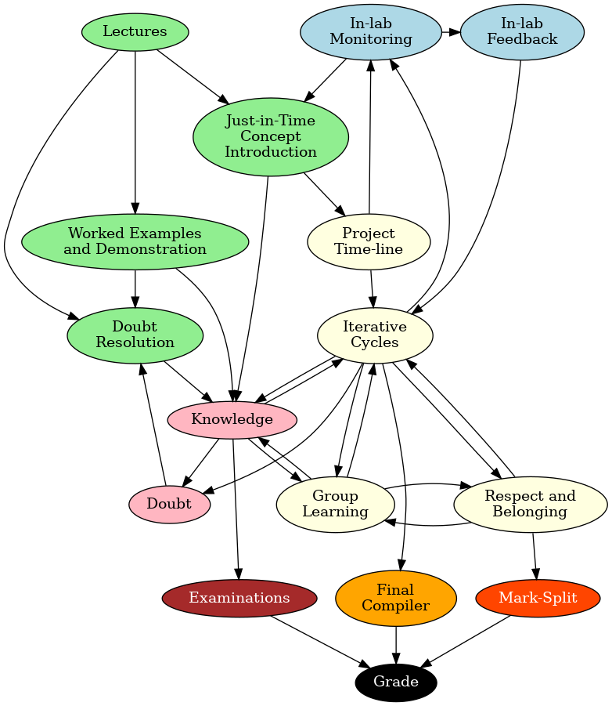
Guided constructionism + Exam + Mark-Split
Pros:
Respect and belonging is also measured through Mark-split method.
Exams provide extra incentive to study (even if freeloading in project).
Cons:
Exam practice and project practice misalignment can cause overload, confusion, and dis-identification
Lack of continuous assessment
No structured sequencing
Still lacking a way to measure practical skills due to underemployed worker problem.

Slide 12
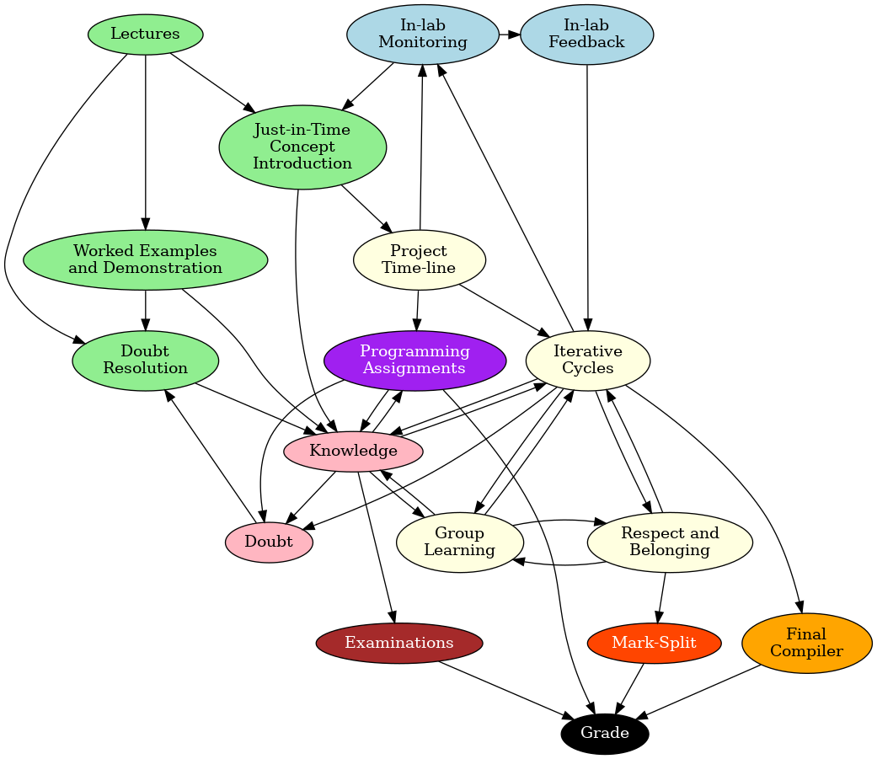
Guided construction with cont. assessment
Pros:
Respect and belonging is also measured through Mark-split method.
Exams provide extra incentive to study (even if freeloading in project).
Cons:
Exam practice and project practice misalignment can cause overload, confusion, and dis-identification
Lack of continuous assessment
No structured sequencing
Still lacking a way to measure practical skills due to underemployed worker problem.

Slide 13
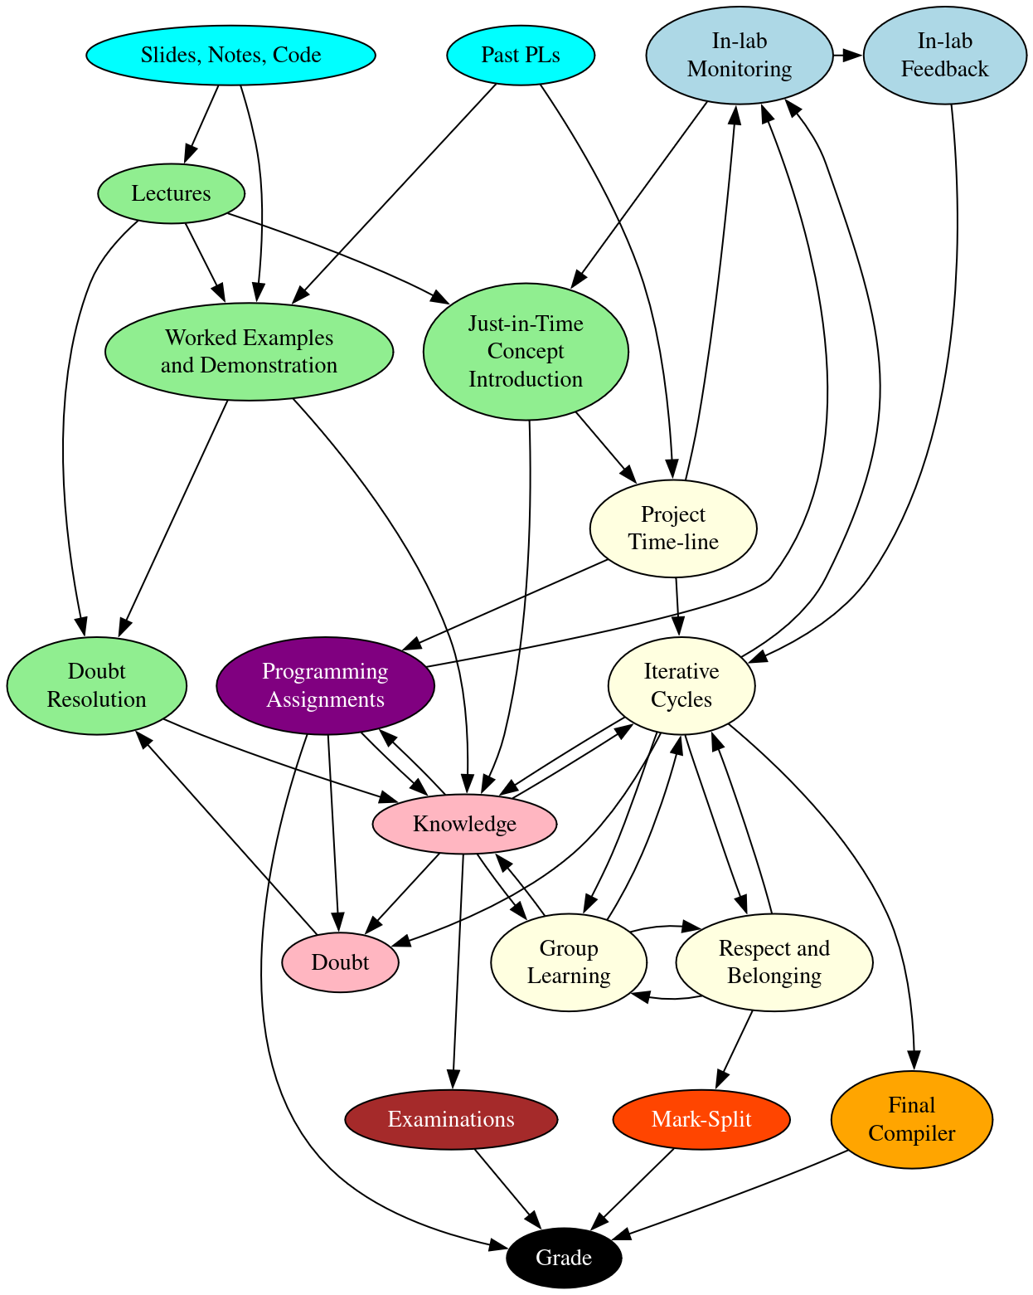

Slide 14
Pedagogical Models Used
Constructionism (Papert): Learning through creating meaningful artifacts.
Knowledge construction via hands-on compiler building.
Cognitive Apprenticeship (Collins et al.):
Guided development of complex skills.
Modeling, scaffolding, articulation, reflection through labs.
Cultural Learning Pathways:
Builds identity, belonging, and long-term professional motivation.

Slide 15
Assessment of Theory Appropriateness
Constructionism: Builds ownership, engagement, and identity.
Cognitive Apprenticeship: Ensures guided competence and skill development.
Why effective: Aligns learning process with real-world problem solving

Slide 16
Evaluation of Learning Design Merits:
Industry-level relevance without abstraction overload.
Just-in-time knowledge ensures meaning and motivation.
Strong scaffolding and peer learning structure.
Fair evaluation through mark-splitting mechanism.
Design Gaps:
Underemployed Worker Problem: Unequal participation among team members.
Lack of Breadth: Focused depth but limited theoretical diversity (e.g., parsing methods).

Slide 17
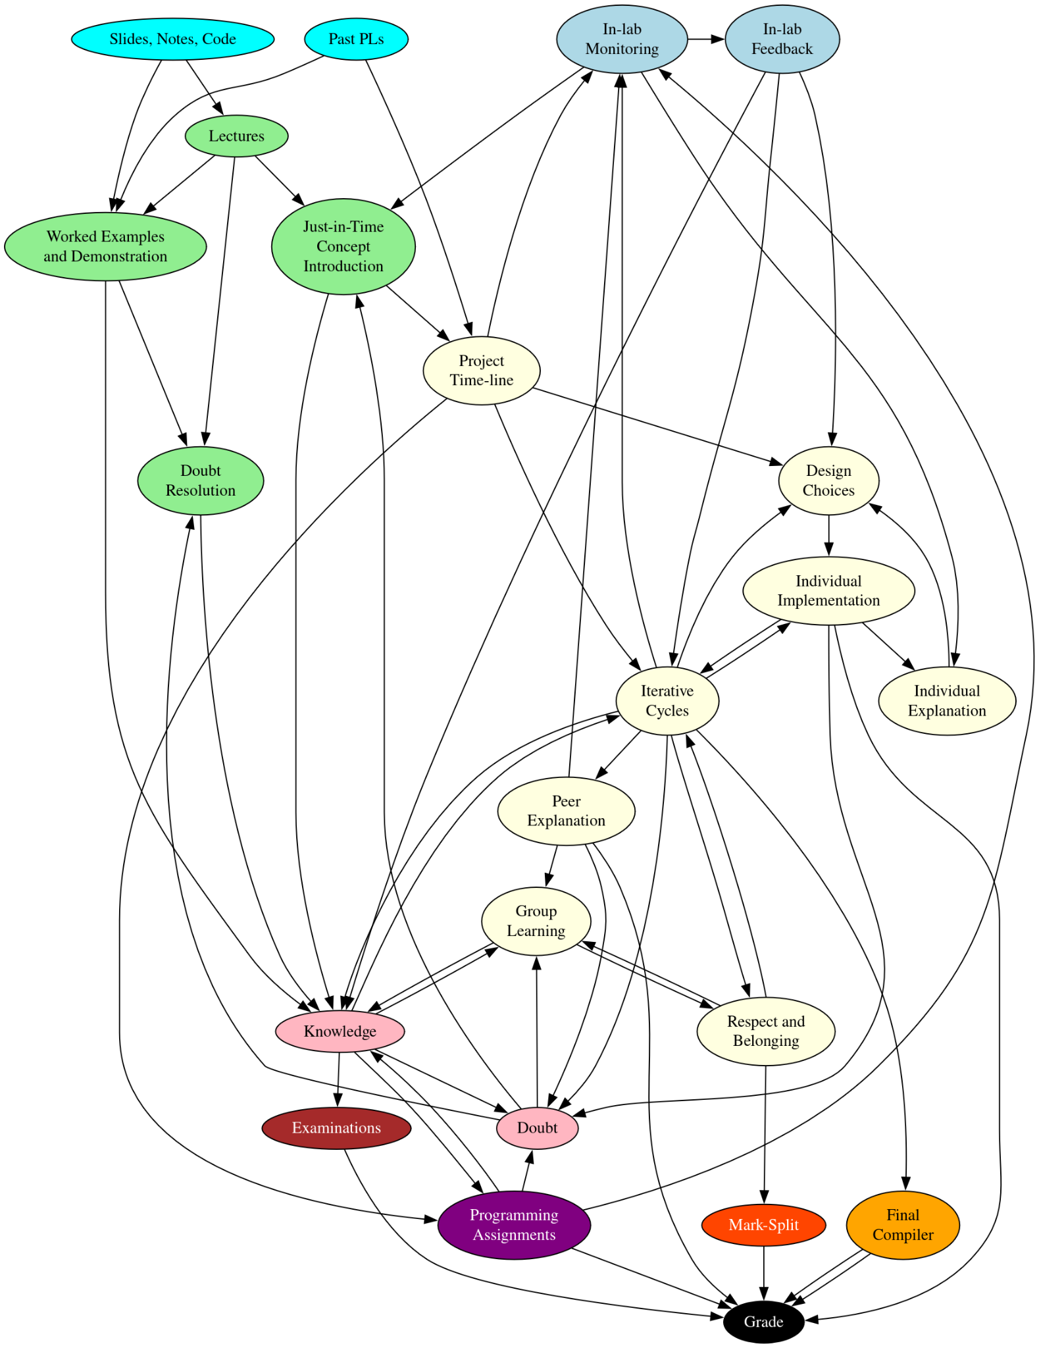
Redesign Features
Mentorship Pairing: Pair old-timers and newcomers for inclusive learning.
Assignment Alignment: Time assignments with project stages for instrumentality.
Distributed Implementation: Different compiler stages for each member to ensure equity and breadth.
Optional Readings (See Also): Expand breadth without cognitive overload.
Expected Outcomes:
  Enhanced inclusivity
  broader exposure
  stronger collaboration
  reflective articulation.

Slide 18
Conclusion
The course effectively used constructionist and apprenticeship models to foster competence, confidence, and identity.
Redesign features aim to bridge inclusion and breadth gaps.
Future iterations can balance depth, diversity, and equitable participation while maintaining authenticity.

Slide 19
Thank You
Question please

